Slide 1

Scalar-tensor Correspondence with f(T) Theory
2011 Cross Strait Meeting on Particle Physics and Cosmology
Yi-Peng Wu 吳亦鵬
Department of Physics,
National Tsing Hua University
1/4/2011

Slide 2

Outline
Introduction
Scalar-Tensor/f(R) Equivalence
Scalar-Tensor/f(T) Correspondence
Remarks

Slide 3
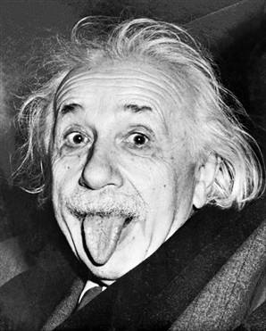
Introduction
General Relativity (1916)
Teleparallel Gravity (1928)

Slide 4
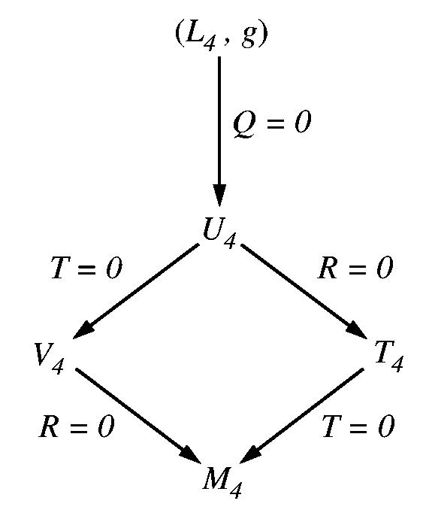
Introduction
GR
f(R)
Scalar-Tensor
TG
f(T)

Slide 5






Introduction
GR
TG

Slide 6

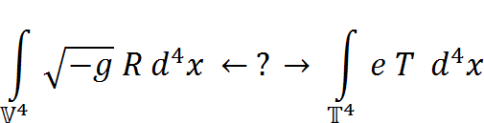
Introduction
TG is empirically equivalent to GR
Hayashi, Shirafuji, PRD(1979)
Today (1993-)
Notes:
New GR is in T4 space-time.
Today’s convention is a special case of 1979’s.

Slide 7
Scalar-Tensor/f(R) Equivalence
2011 Cross Strait Meeting on Particle Physics and Cosmology

Slide 8

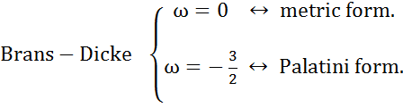
Scalar-Tensor/f(R) Equivalence
Scalar-tensor formulation
Chiba(2003), Falanagan(2004), Sotiriou(2006)
Falanagan(2004), Olmo(2005), Sotiriou(2006)
Notes:
Potential V is important. (prototype with V)

Slide 9





Scalar-Tensor/f(R) Equivalence
Mass of Φ
Faraoni, CQG(2009)
weak-field
slow-motion
Notes:
No experimental constraints on gravity at distances smaller than 0.2 mm.
W has minimum at present Phi.

Slide 10




Scalar-Tensor/f(R) Equivalence
Solar system constraints
Notes:
The profits of this equivalence. Higher order is important.

Slide 11


Scalar-Tensor/f(R) Equivalence
Solar system constraints
Post-Newtonian parameters
Negligible mass :
Notes:
AU ~ 10 ^ 8 km ; Hubble mass scale : ~ 10 ^ - 42 GeV

Slide 12


Scalar-Tensor/f(R) Equivalence
Solar system constraints
Olmo, PRL(2005)
f(R) be ruled out?
→ Chameleon mechanism
Cembranos,2006; Starobinsky,2007……
Notes:
The interaction range of scalar ( l_f(R) ). 0.2mm

Slide 13
Scalar-Tensor/f(T) Correspondence
2011 Cross Strait Meeting on Particle Physics and Cosmology

Slide 14



Scalar-Tensor/f(T) Correspondence
Dark torsion for accelerating Universe
Bengochea, Ferraro, PRD(2009)
Linder, PRD(2010)
Bamba, Geng, Lee, Luo, JCAP(2011)

Slide 15






Scalar-Tensor/f(T) Correspondence
Scalar-tensor formulation
arXiv: 1012.4039

Slide 16






Scalar-Tensor/f(T) Correspondence
Notes:
Same as f(T)

Slide 17

Scalar-Tensor/f(T) Correspondence
PPN parameter
Consistent with cosmological perturbations?
Zheng, Huang, JACP(2011)
Notes:
Laplace of Phi is important.

Slide 18
Remarks
Is this correspondence good?
Local Lorentz violation issue
Progressing work

